Slide 2
Why you should create your next library using .NET Standard
Pandiyan Murugan
Engineer @ Kovai.co
@pandiyan_cool

Slide 3
.NET Core 3 was launched!
But I’m working with .NET 4.0, 4.5, 4.6…
I can’t upgrade all of my code to .NET Core
I have many dependencies
I already run .NET Portability Analyzer and there are many parts of code that are incompatible with .NET Core

Slide 4
How can I use the benefits of .NET Core ?
You have some options:
Rewrite all of your code
Forget every innovations and continue with the same
Create only new projects using .NET Core…
But if you could move some parts of code to .NET Core ?
What do you think about ?

Slide 5
What is .NET Standard?

Slide 6

What is .NET Standard
.NET Standard is a formal specification of .NET APIs
A set of APIs all .NET platforms have to implement
Notes:
You can’t call Operating system specific APIs or framework specific APIs

Slide 7
Welcome to .NET Standard
It’s a way to create a standard implementation between .NET Frameworks
With .NET Standard you write code that is compatible between .NET Framework, .NET Core and Xamarin

Slide 8
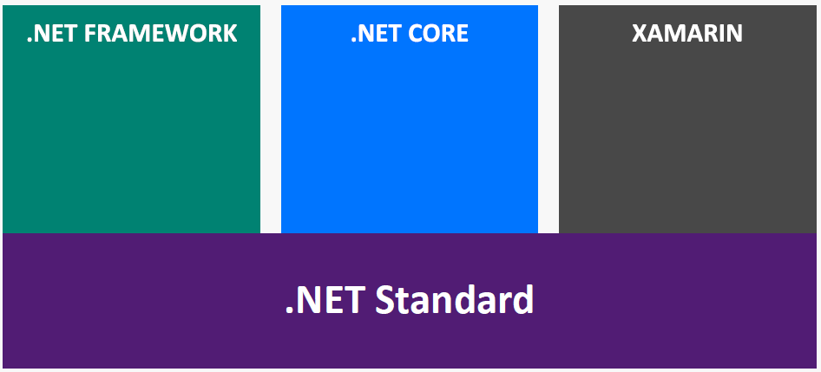
.NET Standard in context
Notes:
End to end experience with an application model UI framework

Slide 9
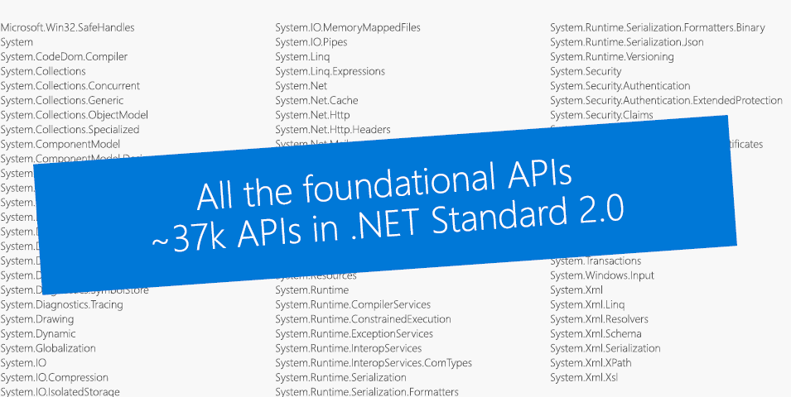
What’s in .NET Standard?

Slide 10
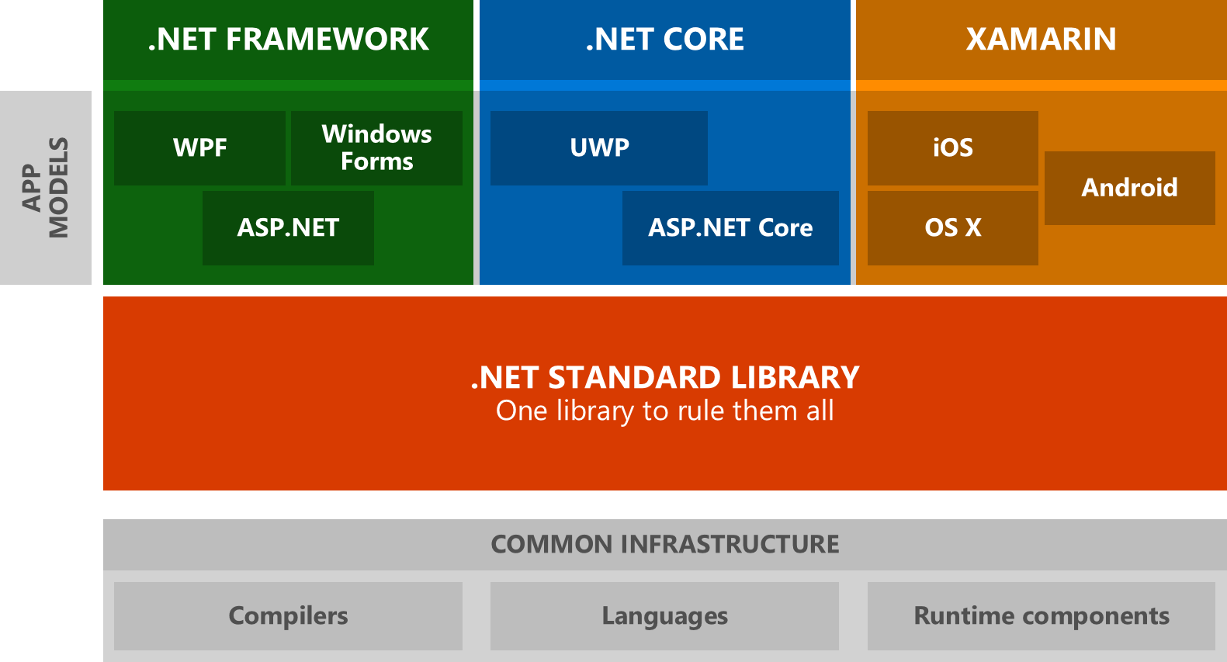
Welcome to .NET Standard

Slide 11
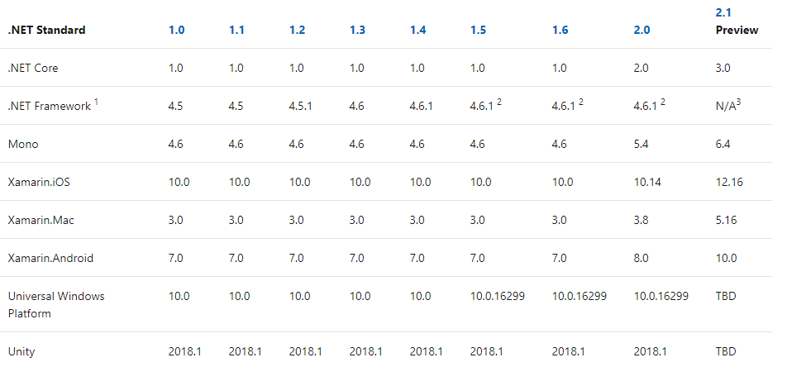
.NET Standard Compatibility
https://docs.microsoft.com/en-us/dotnet/standard/net-standard

Slide 12
.NET Standard Compatibility
https://docs.microsoft.com/en-us/dotnet/standard/net-standard

Slide 13
.NET Standard Compatibility
https://docs.microsoft.com/en-us/dotnet/standard/net-standard

Slide 14
Don’t worry! Start with .NET Standard 2.0

Slide 15
Using platform specific APIs

Slide 16
Windows Compatibility Pack
Microsoft.Windows.Compatibility (Nuget Package)
Can be referenced from .NET Core as well as .NET standard
Has ~21K APIs (Windows only as well as cross platform)
This Windows Compatibility Pack provides access to APIs that were previously available only for .NET Framework.

Slide 17
Detecting usage of unsupported APIs
Use API Analyzer!
https://aka.ms/apianalyzer
Roslyn analyzer that flags usages of APIs that don’t work across all platforms

Slide 18
Building for multiple platforms

Slide 19
Multi-Targeting Best Practices
DO start with .NET Standard 2.0
Most general purpose libraries will not need APIs outside this set
CONSIDER targeting multiple frameworks
If you need to call platform-specific APIs outside of .NET Standard
DO NOT drop support for .NET Standard
Instead, throw from the implementation and offer capability APIs. This way your library can used anywhere and supports runtime light-up
DO share your component using a NuGet Package
It shields consumers from having to pick the appropriate implementation

Slide 20
.NET Framework 4.7.2 is the recommended version to consume .NET Standard 1.5+
Application authors: consider upgrading
Library authors: consider multi-targeting for .NET Framework 4.6.1

Slide 21
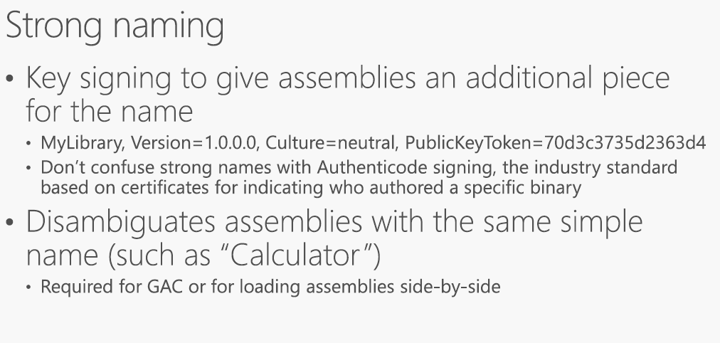

Slide 22
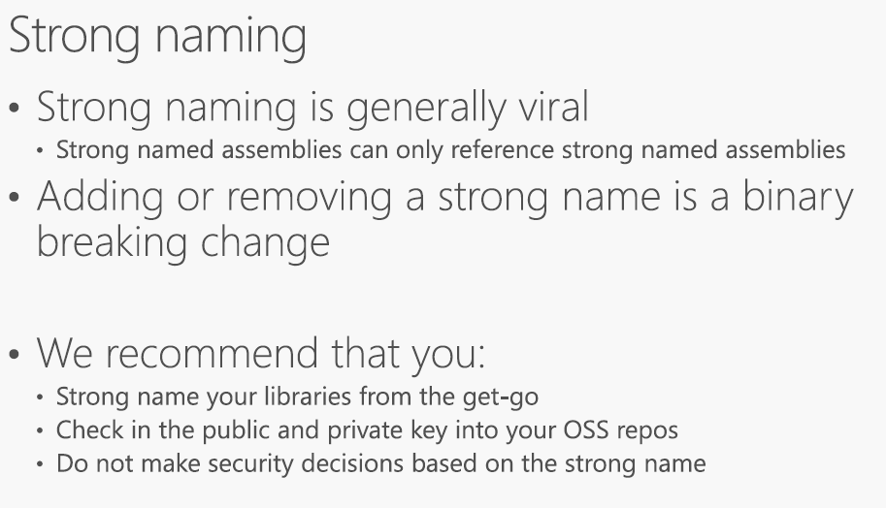

Slide 23
Automatic Binding Redirects

Slide 24
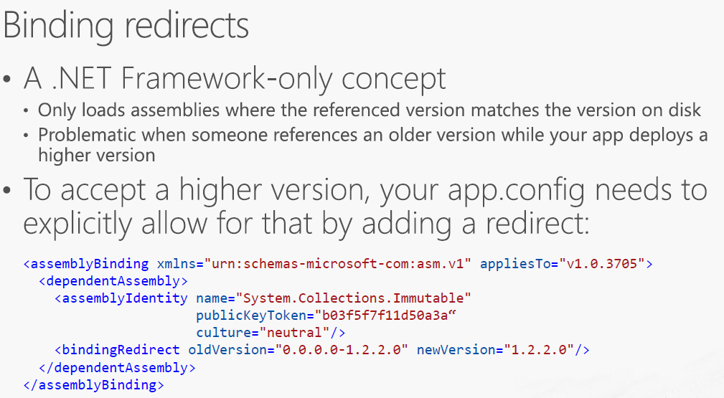

Slide 25
Versioning

Slide 26
Versioning
You need to know about four version numbers
Kind | When to increment | Comment
Package Version | Every change | The ID of the NuGet package.
Assembly Version | As you see fit | The version number of the assembly. Used by the loader to resolve assemblies.
File Version | Every change | Generic concept, used by installers to determine which file is newer.
Informational Version | As you see fit | Display string, doesn’t need to be a version.

Slide 27
.NET Standard – Your choice…
You can move some parts of code to a .NET Standard Library
And you can use the benefits of .NET Core
Better than this, you are improving your code, moving forward
And now you can write some code using .NET Core, working together with your legacy code

Slide 28
.NET Standard 2.1
Unfortunately, version 2.1, that was used in .NET Core 3 is not compatible with .NET Framework
But version 2.0 is ☺
And you can reference projects that use 2.0 in .NET Core 3
It seems confused right ? But is not !!!

Slide 29
How can I use .NET Standard with my legacy ?
First you need to move .NET Framework version to 4.6.1 (at least – recommended 4.7.2)
Second you can move some classes or code that is compatible with .NET Core (use Portability Analyzer) to a .NET Standard 2.0 project
Finally, you can reference .NET Core Libraries in your .NET Framework project
If you have .NET Core projects, you can reference the same library as well

Slide 30
Write your libraries in .NET Standard!

Slide 31
Writing libraries in .NET Standard
You can use the benefits of .NET Core
Create better code and improve your developer's capabilities, that is great ☺
Keep your legacy code running…
And prepare your company to the future!
Remember that .NET 4.8 is the last version of Full Framework

Slide 32
Demo

Slide 33
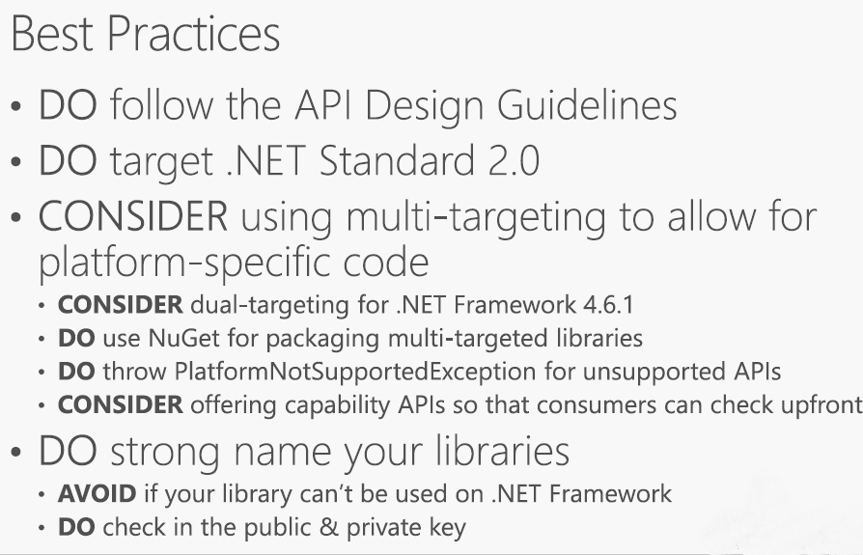

Slide 34
Links
https://docs.microsoft.com/en-us/dotnet/standard/net-standard
https://github.com/dotnet/standard
https://devblogs.microsoft.com/dotnet/announcing-net-standard-2-1

Slide 35


Thanks, Keep supporting ☺
Subscribe to Efficient User
and click the bell icon.
Developer blogs
efficientuser.com
nullablereference.wordpress.com

